Slide 1
Structuring the Data, Computations and Program
PRINCIPLES OF PROGRAMMING LANGUAGES
UNIT -II
PPL - SE SEM II (2016-17)

Slide 2
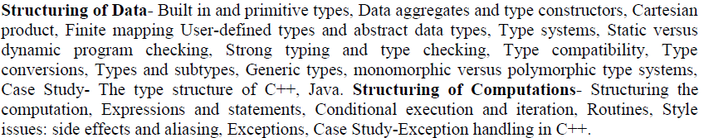
Structuring the Data, Computations and Program

Slide 3
1. Structuring of Data
PL organizes data through concept of TYPE.
Classify data according to different categories.
Type can be defined as set of values and set of operations that can be used to manipulate them.

Slide 4
2. Build-in and Primitive types
Data Type
1. Basic Elements of Specification :
Attributes
Values
Operations
2. Basic Elements of Implementation :
Storage representation
Manner in which operations defined

Slide 5
Classification of Data Types
Data Types
Build In Primary
User defined
Derived
Abstract
Other
Class
File, Set
Array
Enum
Subrange
Structure
Union
Structured data type
int
Real
Char Boolean Elementary data type
Void
Pointer

Slide 6
Integer
Specification:
Represented using numeric values 0 to 9
Sign Is optional. By default , Positive
Four specifications in C, int, short, long, unsigned
Range : In C, 2 bytes for int, 65535 for unsigned & -32678 to +32677 for singed
Operations:
Arithmetic, Relational, Assignment, Bit wise
Implementation

Slide 7
Floating Point (Real)
Specification:
Two ways of representation
Decimal point Notation
Exponential form(scientific Notation)
Representation
[+/-/---] [num]*.[num]+
Operations
Arithmetic, conditional
Implementation
Single precision and double precision

Slide 8
Boolean
Specification:
In Pascal and Ada. Type Boolean = ( False, True)
Generally 1 for True and 0 for False
Operations
Bitwise, AND,OR,NOT etc.
Implementation
Single bit storage
Two ways for representation: 1 for True or 0 for True

Slide 9
Character
Specification:
Character Set depends upon the Language and hardware
E.g. ASCII
Operations
Relational, Assignment, To check value of char
Implementation
One byte per char, unsinged ( 0 – 256),
signed (-127 to +126)

Slide 10
3. Data Aggregates and type constructors

Slide 11
Introduction
Aggregates Derived from basic or elementary data types
“A data-object that is constructed as an aggregate of other data-objects called components.”
Example: array which aggregates homogeneous type elements

Slide 12
Array
Attributes
Number of components (Array Size)
Data Type of Components
Subscript
Operations
Subscripting,
create & destroy array,
assignment to component of an Array
Arithmetic on pair of arrays of same size

Slide 13
3.1 Cartesian Product
In programming language it is viewed as composition of fields.
Example: polygon declared as integer(no of edges) and real (size of edge).
Structure in C,C++, Algol68, PL/I
Records in COBOL, Pascal and Ada.

Slide 14
3.2 Finite Mapping
Associating values from one set (domain of function) to values in another set(range of function).
Array : index range is domain of mapping and values stored in array are range of mapping.
Indexing
Subset i.e. values are fixed at compile time or run time.
Dynamic arrays in ALGOL 60 and Ada
Vectors in C++ : flexible array ( memory space may change during execution, allocation at heap)

Slide 15
3.3 Union and discriminated Union
Union
Union allocates one common storage space for all its members.
can access only one member of union at a time
Discriminated Union
Safer than union.
Type checking performed at run time in both.

Slide 16
Union Example
union Data data;
data.i = 10;
data.f = 220.5;
strcpy( data.str, "C Programming");
printf( "data.i : %d\n", data.i);
printf( "data.f : %f\n", data.f);
printf( "data.str : %s\n", data.str);
return 0;
}
#include <stdio.h>
#include <string.h>
union Data {
int i;
float f;
char str[20];
};
int main( ) {
data.i : 1917853763
data.f : 4122360580327794860452759994368.000000
data.str : C Programming

Slide 17
Sequence
Arbitrary number of occurrences of elements .
Arrays and recursive list
Vectors and list in C++
List in LISP and PROLOG

Slide 18
Insecurities of Pointer
Dangling Pointer
Pointer if refers to a location that is no longer allocated for holding value of interest.
Deallocation of heap variables which may create dangling pointer.
Pointer to be component of union.

Slide 19
Enumeration
•
Specification:
Improve readability of a program i.e. 0 = False
Also known as “User defined ordinal Type”
E.g. enum color { Red, Blue, Green };
Internally it is Red = 0, Blue = 1, Green = 2
Operations
Can be used as array subscript, loop variable, case selector
Relational operations
Ordinal operations
Successor
Predecessor
•

Slide 20
Implementation
It is ordered list of distinct values
Storage representation is straight forward
Value of enumerated sequence is represented by one of the integer 0,1,2,3…
By default values can be 0,1,2,3,…
User can override this and set new value desired
E.g. enum stud { abc = 25, xyz = 30, aaa, bbb}
Aaa = 31, bbb = 32 etc.

Slide 21
Example
#include <stdio.h>
enum week { sunday, monday, tuesday, wednesday, thursday, friday, saturday };
int main()
{
enum week today;
today = wednesday;
printf("Day %d",today+1);
return 0;
}
Day 4

Slide 22
Unit – II : Structuring the Data, computations and Program
Build-in and Primitive types
Data aggregates and type constructors
Structuring of Data
Structuring of Computation
1.3 User defined types and ADT
1.4 Type Systems
1.5 Type structure of C++ and Java

Slide 23
User defined types and ADT
•
Data structure is a data object that contains other data objects as its elements
A data object that is termed as aggregate of other data objects is a data structure or structured data object
3 important aspects
Specifications
Operations
Storage representation
•
•

Slide 24
Specifications:
Major Attributes include
No. of components
Type of each component
Component selection criteria
Maximum number of components
Organization of components
Operations
Component selection
Insertion and deletion of components
Creation and destruction of data structure

Slide 25
Storage Representation
Storage for components of it
Descriptor that stores attributes of data structure
Optional
Two types
Sequential
Linked representation

Slide 26
Record/Structure
•
Specification:
Record is a data structure composed of a fixed number of components of different type
Components of record may be heterogeneous
Components of records are named with symbolic names rather than integer index.
Attributes:
No. of component
Data type of each component
Selector used to name each component
•

Slide 27
Implementation
– Storage representation consist of single sequential block of memory
1234
23
15000
IT
ID
AGE
SALARY
DEPT.
Employee Record Struct employee
{ int id, age; float salary; char dept[10];
}emp;

Slide 28
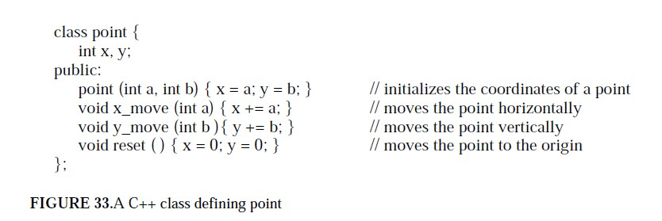
Abstract Data Types
Ada – Package
C++ - Class
ADT has data and functions encapsulated together

Slide 29
Unit – II : Structuring the Data, computations and Program
Build-in and Primitive types
Data aggregates and type constructors
Structuring of Data
Structuring of Computation
1.3 User defined types and ADT
1.4 Type Systems
1.5 Type structure of C++ and Java

Slide 30
Type Systems
A binding is static if it occurs before run time and remains unchanged throughout program execution.
A binding is dynamic if it occurs during execution or can change during execution of the program.
Type binding issues
How is a type specified?
When does the binding take place?
If static, type may be specified by either an explicit or an implicit declaration

Slide 31
Type - coercion
PL's differ in their approach to type coercion
Coercion refers to automatic conversion from one type to another
If a PL is strongly typed, then coercion is restricted and/or explicit
If a PL is weakly typed, then coercion is taken care of by the compiler, which might cause errors
In recent years, the trend is towards strong typing

Slide 32
Type – Dynamic Type Binding
The type of a variable can chance during the course of the program and, in general, is re-determined on every assignment.
Usually associated with languages first implemented via an interpreter rather than a compiler.
Specified through an assignment statement, e.g. APL
LIST <- 2 4 6 8
LIST <- 17.3 23.5
Advantages:
Flexibility
Obviates the need for “polymorphic” types
Development of generic functions (e.g. sort)
Disadvantages:
High cost (dynamic type checking and interpretation)
Type error detection by the compiler is difficult

Slide 33
Type – Inferencing
Type Inferencing is used in some programming languages, including ML, Miranda, and Haskell.
Types are determined from the context of the reference, rather than just by assignment statement.
Legal:
fun circumf(r) = 3.14159 * r * r; fun time10(x) = 10 * x;
Illegal:
fun square(x) = x * x;
Fixed
fun square(x) : int = x * x;
// infer r is real
// infer x is integer
// can’t deduce anything
// use explicit declaration

Slide 34
Type – Checking
Generalize the concept of operands and operators to include subprograms and assignments
Type checking is the activity of ensuring that the operands of an operator are of compatible types
A compatible type is one that is either legal for the operator, or is allowed under language rules to be implicitly converted, by compiler-generated code, to a legal type.
This automatic conversion is called a coercion.
A type error is the application of an operator to an operand of an inappropriate type
Note:
If all type bindings are static, nearly all checking can be static If type bindings are dynamic, type checking must be dynamic
●

Slide 35
Type – Strong Typing
A programming language is strongly typed if type errors are always detected
There is strict enforcement of type rules with no exceptions.
All types are known at compile time, i.e. are statically bound.
With variables that can store values of more than one type, incorrect type usage can be detected at run-time.
Strong typing catches more errors at compile time than weak typing, resulting in fewer run- time exceptions.
●

Slide 36
Type – Strong Typing
FORTRAN 77 isn’t strongly typed because it doesn’t check parameters because of variable equivalence statements.
The languages Ada, Java, and Haskell are strongly typed.
Pascal is (almost) strongly typed, but variant records screw it up.
C and C++ are sometimes described as strongly typed, but are perhaps better described as weakly typed because parameter type checking can be avoided (how?) and unions are not type checked
Coercion rules strongly affect strong typing—they can weaken it considerably (C++ versus Ada)

Slide 37
Type – Compatibility
Type compatibility by name means the two variables have compatible types if they are in either the same declaration or in declarations that use the same type name
Easy to implement but highly restrictive:
Subranges of integer types aren’t compatible with integer types
Formal parameters must be the same type as their corresponding actual parameters (Pascal)
Type compatibility by structure means that two variables have compatible types if their types have identical structures
More flexible, but harder to implement

Slide 38
Type Conversion
Converting a value from one data type to another called type conversion.
Implicit Conversion – Coercion
Explicit Conversion – Type casting
Implicit conversion performed by compiler automatically.
Explicit conversion is performed by operator cast.

Slide 39
Type conversion Example
Implicit conversion (Coercion)
float f=10;
Explicit conversion
int a;
Float b=7.8;
a= (int)b;
Truncate real value 7.8 to 7

Slide 40
Type –
Generic types
template
generic
C++ templates are completely type safe at compile time.
Notes:
a template is a mechanism that allows a programmer to use types as parameters for a class or a function. The compiler then generates a specific class or function when we later provide specific types as arguments. In a sense, templates provide static (compile-time) polymorphism, as opposed to dynamic (run-time) polymorphism. A function/class defined using template is called a generic function/class, and the ability to use and create generic functions/classes is one of the key features of C++.
We can think of a class template as a type generator. The process of generating types from a class template is called specialization or template instantiation.
In most of the cases, template instantiation is very complicated, but that complexity is in the domain of compiler writer, not the template user. Template instantiation takes place at compile time or link time, not at run time.
Templates are the foundation of generic programming. Generic programming relies on polymorphism. Though there are several differences between OOP (class hierarchies and virtual functions) and generic programming (templates), the major difference is:
Generic (templates) : compile time resolution. The choice of function invoked when we use is determined by the compiler at compile time.
OOP (virtual functions) : run time resolution.
Generic programming lets us write classes and functions that are polymorphic across unrelated types at compile time. A single class or function can be used to manipulate objects of a variety of types. The standard library containers, iterators, and algorithms are examples of generic programming. We can use library classes and functions on any kind of type.
When we parameterize a class, we get a class template, and when we parameterize a function, we get a function template.
So, what do people actually use template for?
When performance is essential.
When flexibility in combining information from several types is essential.
Template Parameters These names are listed after the template keyword in a template declarations. As shown in the example, T is the single template parameter specified in the Stack class.
Template Arguments These are substituted for template parameters during specialization. In our example, given a specialization Stack<int>, the int is a template argument.
Instantiation This is when the compiler generates a regular class, method, or function by substituting each of the template's parameters with a concrete type. This can happen implicitly when we create an object based on a template or explicitly if we want to control when the code generation happens. For instance, the following code creates two specific stack instances and will normally cause the compiler to generate code for these two different types:
Stack<T> myIntStack; Stack<T> myStringStack;
Implicit Instantiation This is when the compiler decides when to generate code for our template instances. Leaving the decision to the compiler means that it must find an appropriate place to insert the code, and it must also make sure that only one instance of the code exists to avoid duplicate symbol errors. This is non-trivial problem and can cause extra bloat in our object files or longer compile time. Most importantly, implicit instantiation means that we have to include the template definitions in our header files so that the compiler has an access to the definitions whenever it needs to generate the instantiation code.
Emplicit Instantiation This is when the programmer determine when the compiler should generate the code for a specific specialization. This can make for much more efficient compilation and link times because the compiler no longer needs to maintain bookkeeping information for all of its implicit instantiations. The onus, however, is then placed on the programmer to ensure that a particular specialization is explicitly instantiated only once. So, explicit instantiation allows us to move the template implementation into the .cpp file, and so hide from the user.
Lazy Instantiation This describes the standard implicit instantation behavior of a C++ compiler wherein it will only generate code for the parts of a template that are actually used. Given the previous two instantiations, for example, if we never called isEmpty() on the myStringStack object, then the compiler would not generate code for the std::string specialization of that method. This means that we can instantiate a template with a type that can be used by some, but not all methods of a class template. If one method uses the >= operator, but the type we want to instantiate does not define this operator. This is fine as long as we don't call the particular method that attempts to use the >= operator.
Specialization When a template is instantiated, the resulting class, method, or function is called a specialization. More specifically, this is an instantiated (or generated) specialization. However, the term specialization can also be used when we provide a custom implementation for a function by specifying concrete types for all the template parameters. The following is called an explicit specialization:
tempate<> void Stack<int>::push(int val) { // integer specific push implementation }
Partial Specialization This is when we provide a specialization of the template for a subset of all possible cases. In other words, we specialize one feature of the template but still allow the user to specify other features. For example, if our template accepts multiple parameters, we could partially specialize it by defining a case where we specify a concrete type for only one of the parameters. In our Stack example with a single template parameter, we could partially specialize this template to specifically handle pointers(*) to any type T. This still lets users create a stack of any type, but it also lets us write specific logic to handle the case where users create a stack of pointers. This partially specialized class declaration looks like this:
template <typename T>
Pros and Cons of Templates
Pros
It provides us type-safe, efficient generic containers and generic algorithms
The main reason for using C++ and templates is the trade-offs in performance and maintainability outweigh the bigger size of the resulting code and longer compile times.
The drawbacks of not using them are likely to be much greater.
Cons
Templates can lead to slower compile-times and possibly larger executable.
Compilers often produce incomprehensible poor error diagnostics and poor error messages.
The design of the STL collections tends to lead to a lot of copying of objects. The original smart pointer, std::auto_ptr, wasn't suitable for use in most collections. Things could be improved if we use other smart pointers from boost or C11.

Slide 41
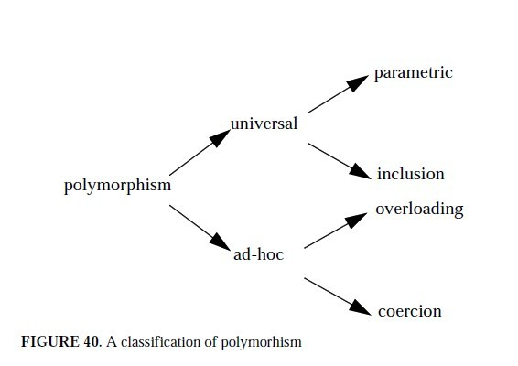
Monomorphic Vs Polymorphic
1.4 Type –

Slide 42
Monomorphic: For some languages , it is possible to verify that any occurrences of constant, variable or routines is type correct at compile time. Such type system is called as Monomorphic.
In polymorphic PL, every variable can belong to more than one type.
Ad-hoc polymorphism-overloading and coercion

Slide 43
Unit – II : Structuring the Data, computations and Program
Build-in and Primitive types
Data aggregates and type constructors
Structuring of Data
Structuring of Computation
1.3 User defined types and ADT
1.4 Type Systems
1.5 Type structure of C++ and Java

Slide 44
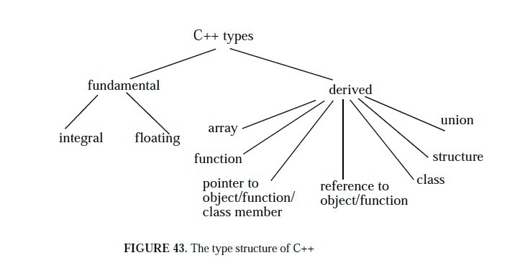
Type structure of C++ and Java

Slide 45
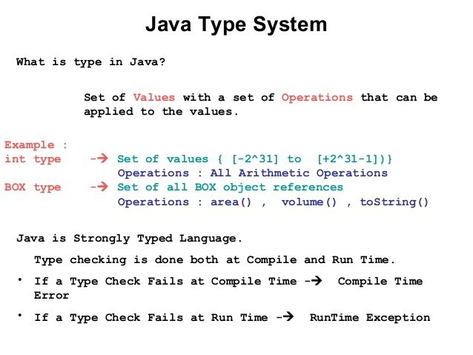
Type structure of C++ and Java

Slide 46
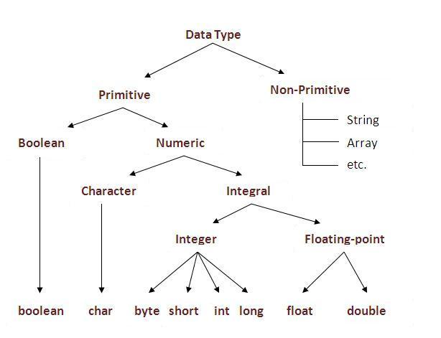
data types in Java

Slide 47
Primitive Data Types
Java has eight primitive data types as described below.
Type | Size/Format | Range
byte | 8-bit two's complement | -128 to 127
short | 16-bit two's complement | -32,768 to 32,767
int | 32-bit two's complement | about –2 billion to 2billion
long | 64-bit two's complement | about –10E18 to +10E18
float | 32-bit IEEE 754 | -3.4E38 to +3.4E38
double | 64-bit IEEE 754 | 1.7E308 to 1.7E308
char | 16-bit Unicode character | A single character
boolean | true or false | true or false

Slide 48
Expressions and Statements
Expression : Compute or obtain value by combining other values with operators.
r-value of variables
Operators characterized by arity ( Required number of operands)
Unary
Binary
n-ary
With order of execution
Infix
prefix
Postfix

Slide 49
Expressions and Statements
Conditional Expression :
a>b ? c : d Conditional operator
If-else
Switch case
Assignment Statement A = B
Iterative
For
While
Do- while

Slide 50
Conditional Execution and Iteration
Conditional Execution
if-else
nested if-else
Switch case
Iteration
Number of actions to be executed repeatedly
while
for
do-while
break and continue keywords

Slide 51
Routines
Procedures
does not return a value. (Pascal and Ada)
Functions
Return a value.
Side effect and aliasing
Modification of actual parameters i.e by pass by reference is side effect , which may produce undesired result.
A modification of data object under one variable name is automatically visible through its aliases.

Slide 52
Exception
Exception handling in C++.

Slide 53
Introduction
Exceptions
Indicate problems that occur during a program’s execution
Occur infrequently
Exception handling
Can resolve exceptions
Allow a program to continue executing or
Notify the user of the problem and
Terminate the program in a controlled manner
Makes programs robust and fault-tolerant

Slide 54
Exception in C++
Generated by runtime environment (divide by zero)
Raised explicitly by the program.
throw
try
catch
Common failures
new not allocating memory
Out of bounds array subscript
Division by zero
Invalid function parameters

Slide 55
Expressions handling in C++
try {
try
// ...
}
catch (ibuf)
{
// handle input buffer overflow
}
catch (io)
{
// handle any io error
}
catch (stdlib)
{
// handle any library exception
}
Catch (...)
{
// handle any other exception
●
●
catch
●
throw
}

Slide 56
Throwing an Exception
throw - indicates an exception has occurred
Usually has one operand (sometimes zero) of any type
If operand an object, called an exception object
Conditional expression can be thrown
Code referenced in a try block can throw an exception
Exception caught by closest exception handler
Control exits current try block and goes to catch handler (if it exists)
Example (inside function definition)
if ( denominator == 0 )
throw DivideByZeroException();
Throws a dividebyzeroexception object

Slide 57
Catching an Exception
Exception handlers are in catch blocks
Format: catch( exceptionType parameterName){
exception handling code
}
Caught if argument type matches throw type
If not caught then terminate called which (by default) calls abort
Example:
catch ( DivideByZeroException ex) {
cout << "Exception occurred: " << ex.what() <<'\n'
}
Catches exceptions of type DivideByZeroException

Slide 58
int main ( ) {
int x = 50;
int y = 0;
double z = 0;
try {
z = division(x, y);
cout << z << endl;
}catch (const char* msg) {
cerr << msg << endl;
}
return 0;
}
#include <iostream>
using namespace std;
double division(int a, int b)
{
if( b == 0 ) {
throw "Division by zero condition!";
}
return (a/b);
}
Division by zero condition!

Slide 59
#include <iostream>
using namespace std;
int main ( ) {
try
{
throw 20;
}
catch (int e)
{
cout << "An exception occurred Exception No. " << e << '\n';
}
return 0;
}
OUTPUT :
An exception occurred Exception No. 20

Slide 60
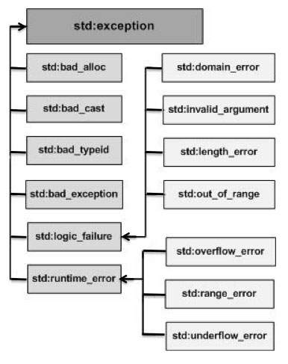
C++ Standard Exceptions
throw std::bad_alloc();

Slide 61
Exception | Description
std::exception | An exception and parent class of all the standard C++ exceptions.
std::bad_alloc | This can be thrown by new on allocation failure
std::bad_cast | This can be thrown by dynamic_cast when it fails in a dynamic cast
std::bad_exception | This is useful device to handle unexpected exceptions in a C++ program
std::bad_typeid | This can be thrown by typeid.
std::logic_error | An exception that theoretically can be detected by reading the code.
std::domain_error | This is an exception thrown when a mathematically invalid domain is used

Slide 62
std::invalid_argument | This is thrown due to invalid arguments.
std::length_error | This is thrown when a too big std::string is created
std::out_of_range | This can be thrown by the at method from for example a std::vector and std::bitset<>::operator[]().
std::runtime_error | An exception that theoretically can not be detected by reading the code.
std::overflow_error | This is thrown if a mathematical overflow occurs.
std::range_error | This is occured when you try to store a value which is out of range.
std::underflow_error | This is thrown if a mathematical underflow occurs.

Slide 63
Define New Exception
By inheriting and overriding exception class functionality.

Slide 64
#include <iostream>
#include <exception>
using namespace std;
struct MyException : public exception {
const char * what () const throw ()
{
return "C++ Exception";
}
};
int main() {
try {
throw MyException();
}catch(MyException& e) {
std::cout << "MyException caught" << std::endl;
std::cout << e.what() << std::endl;
} catch(std::exception& e) {
//Other errors
}
}
MyException caught
C++ Exception

Slide 65
Thank You

Slide 66
Void pointer
void *
a pointer that points to some data location in storage, which doesn’t have any specific type
If we assign address of char data type to void pointer it will become char Pointer
Any pointer type is convertible to a void pointer hence it can point to any value.

Slide 67
printf("Integer variable is = %d", *( (int*) ptr) );
// void pointer is now float
ptr = &y;
printf("\nFloat variable is= %f", *( (float*) ptr) );
return 0;
}
#include<stdlib.h>
int main()
{
int x = 4;
float y = 5.5;
void *ptr; //A void pointer
ptr = &x;
// (int*)ptr - does type casting of void
// *((int*)ptr) dereferences the typecasted void pointer variable.
Integer variable is = 4 Float variable is= 5.500000

Slide 68
NULL Pointer
NULL Pointer is a pointer which is pointing to nothing.
In case, if we don’t have address to be assigned to a pointer, then we can simply use NULL.
Important Points
NULL vs Uninitialized pointer – An uninitialized pointer stores an undefined value. A null pointer stores a defined value, but one that is defined by the environment to not be a valid address for any member or object.
NULL vs Void Pointer – Null pointer is a value, while void pointer is a type

Slide 69
#include <stdio.h>
int main()
{
// Null Pointer
int *ptr = NULL;
printf("The value of ptr is %u", ptr);
return 0;
}
The value of ptr is 0

Slide 70
Dangling Pointer
A pointer that doesn't actually point at anything valid.
Dangling pointers arise during object destruction, when an object that has an incoming reference is deleted or deallocated, without modifying the value of the pointer, so that the pointer still points to the memory location of the deallocated memory.

